Slide 1



YouTube Streamer Analysis
Miracle Ogunnusi
INTERN CAREER PRESENTATION

Slide 2

Description
Dataset : Top 1000 YouTubers statistics
This dataset contains valuable information about the top YouTube streamers, including their ranking, categories, subscribers, country, visits, likes, comments, and more.
The task is to perform a comprehensive analysis of the dataset to extract insights about the top YouTube content creators.

Slide 3
Questions
1. Data Exploration:
- Start by exploring the dataset to understand its structure and identify key variables.
- Check for missing data and outliers.
2. Trend Analysis:
- Identify trends among the top YouTube streamers. Which categories are the most popular?
- Is there a correlation between the number of subscribers and the number of likes or comments?
3. Audience Study:
- Analyze the distribution of streamers' audiences by country. Are there regional preferences for specific content categories?
4. Performance Metrics:
- Calculate and visualize the average number of subscribers, visits, likes, and comments.
Are there patterns or anomalies in these metrics?
5. Content Categories:
- Explore the distribution of content categories. Which categories have the highest number of streamers?
- Are there specific categories with exceptional performance metrics?
6. Benchmarking:
- Identify streamers with above-average performance in terms of subscribers, visits, likes, and comments.
- Who are the top-performing content creators?
7. Content Recommendations:
- Propose a system for enhancing content recommendations to YouTube users based on streamers' categories and performance metrics.

Slide 4
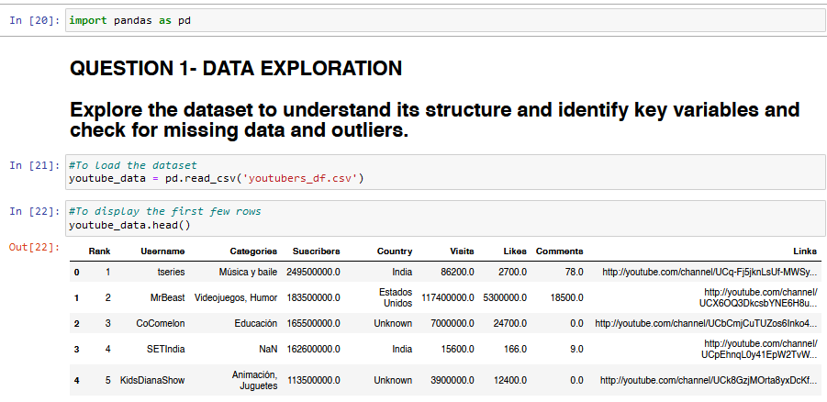

Slide 5
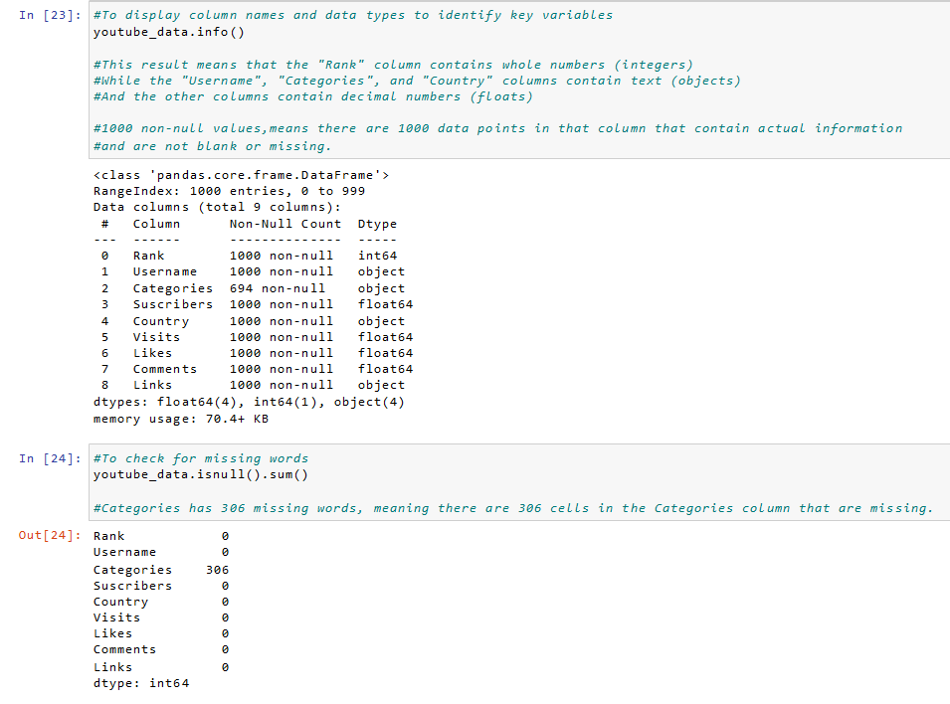

Slide 6
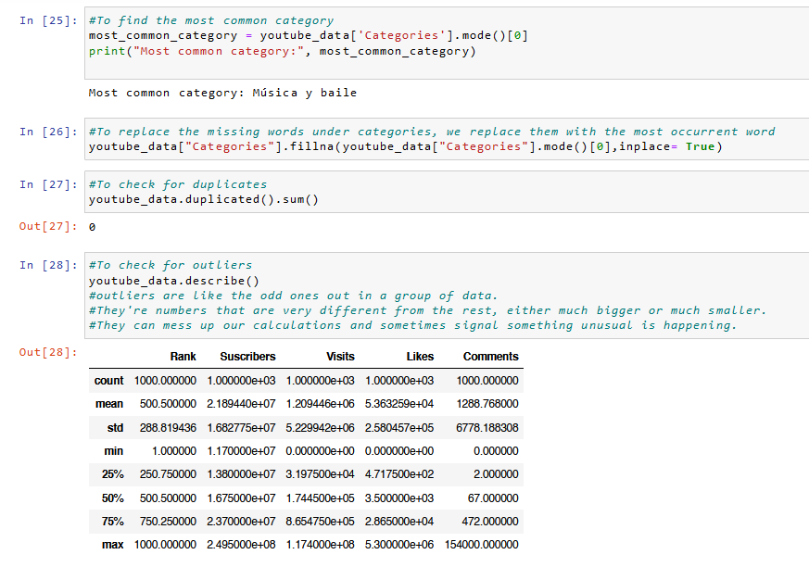

Slide 7
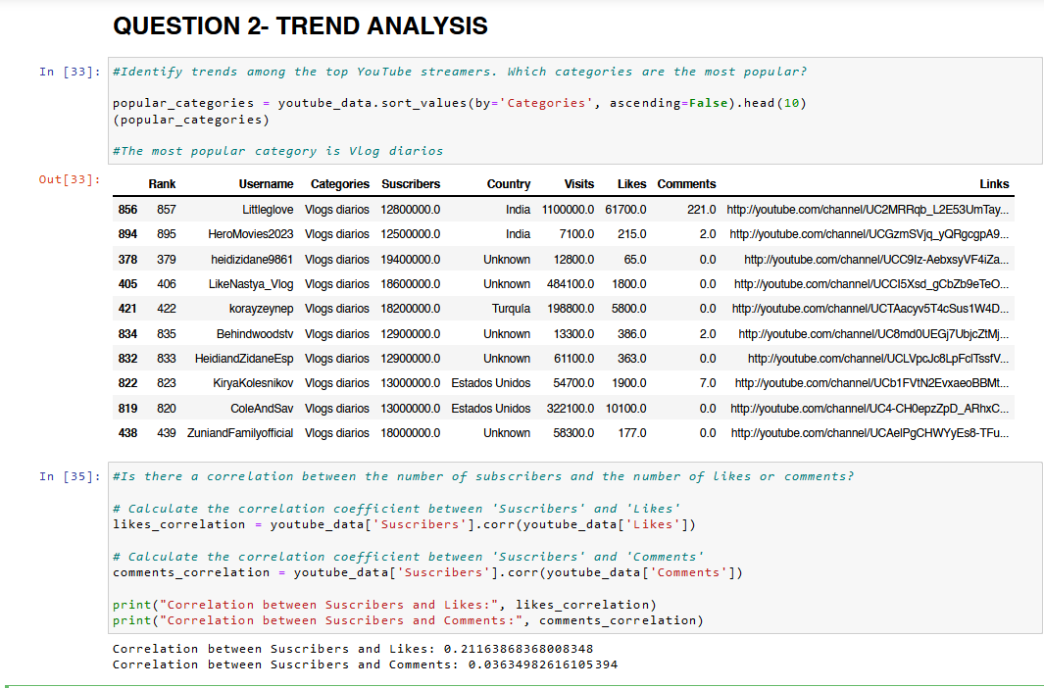

Slide 8
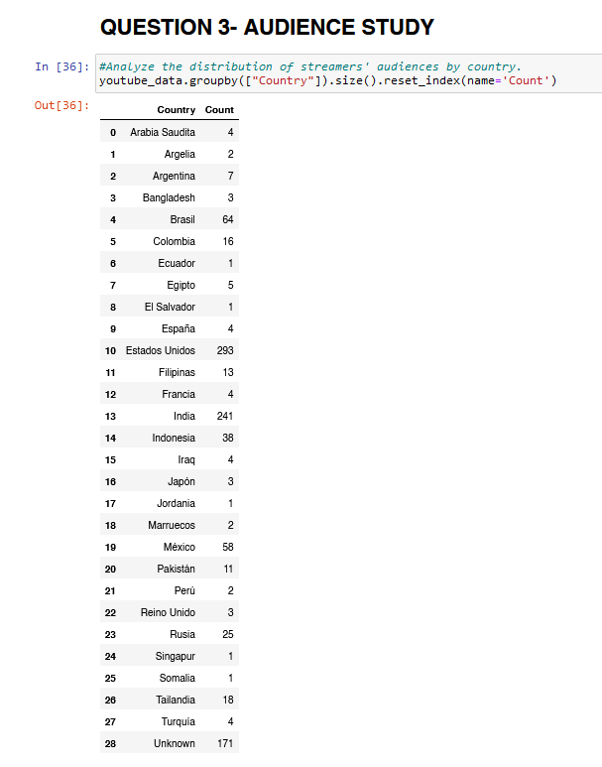
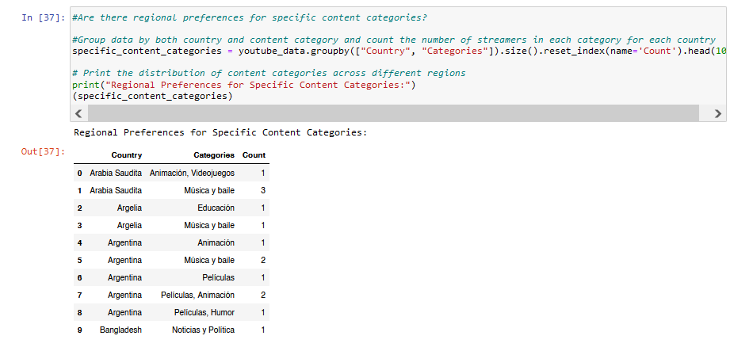

Slide 9
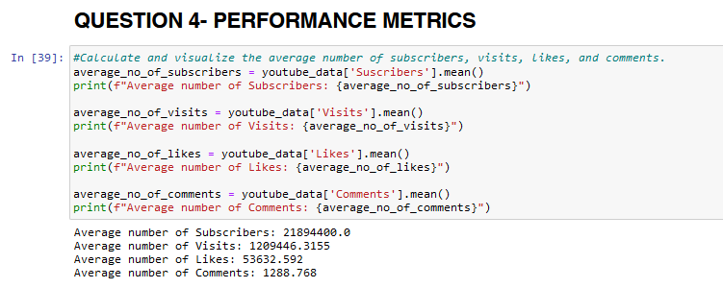

Slide 10
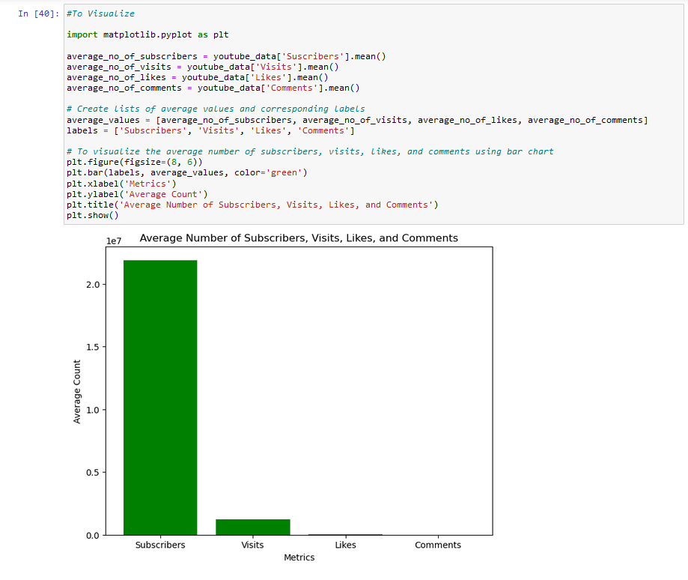

Slide 11
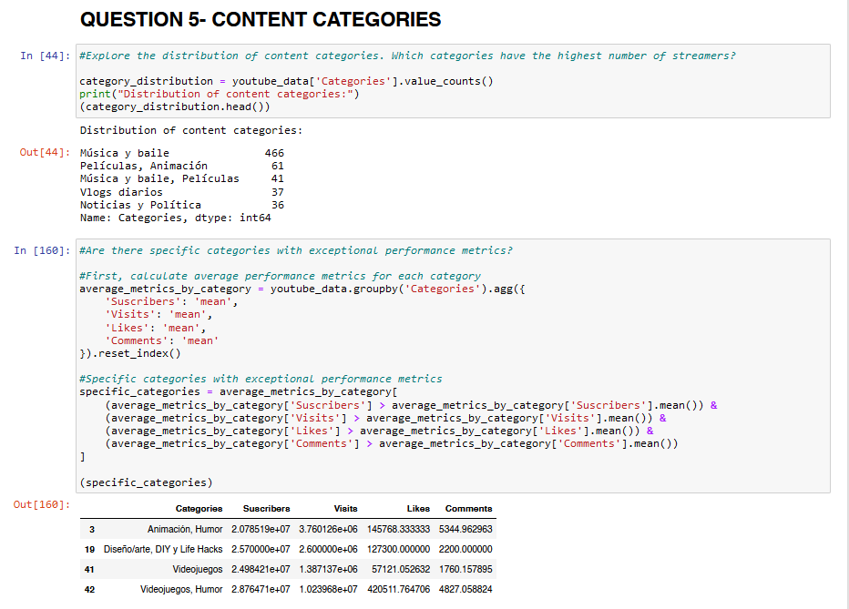

Slide 12
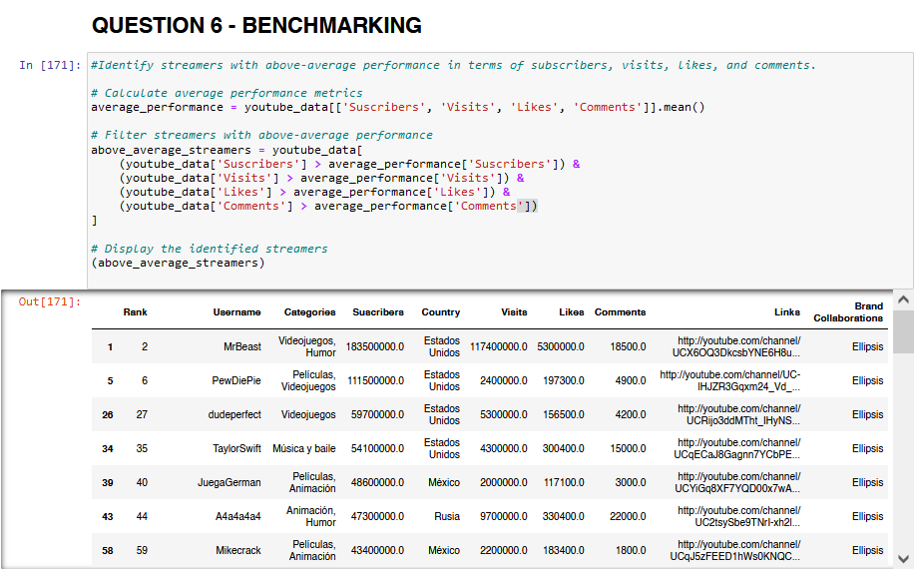

Slide 13
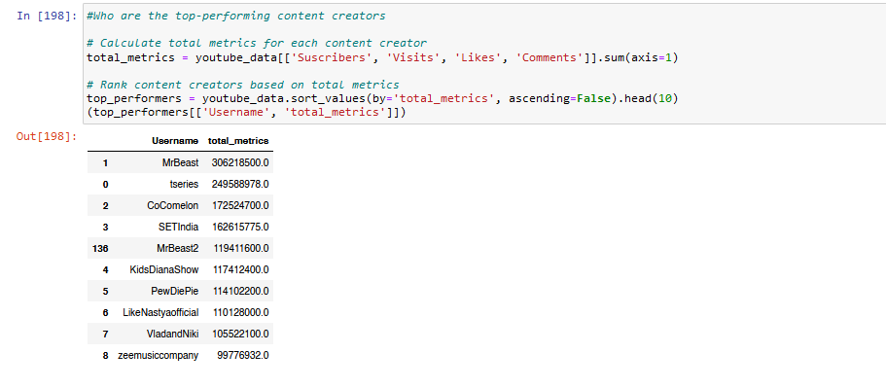

Slide 14
QUESTION 7 - PROPOSE A SYSTEM FOR ENHANCING CONTENT RECOMMENDATIONS TO YOUTUBE USERS BASED ON STREAMERS‘
Have you ever scrolled through YouTube looking for something interesting to watch, but felt lost in a sea of options? This proposal outlines a new system to improve YouTube recommendations, helping you discover streamers you love
Imagine this: Instead of random suggestions, YouTube uses two key things to pick the perfect channels for you:
What streamers are good at: This includes the kind of content they create (music, comedy, drama, etc.) and how viewers respond (likes, comments, views)
What you enjoy watching: The system learns from the videos you already watch and recommends similar streamers you might enjoy.
Here's how it would work
Gathering Information: YouTube would collect details about streamers, like their content category and how viewers engage with their videos. It would also keep track of the channels you watch and how long you stick around.
Making Connections: Using this information, the system would find connections between streamers and viewers. For example, if you love watching cooking videos, it might recommend other channels with cooking content.
Learning and Adapting: The system would constantly learn and improve. If you keep watching a particular streamer the system suggested, it would take note and recommend similar channels in the future. If you never click on a suggested video, the system would learn from that too and adjust its recommendations.
Always Getting Better: By constantly learning from both streamers and viewers, YouTube could create a recommendation system that feels personal. Imagine a system that can not only suggest channels you'll enjoy, but also help you discover exciting new content creators you might have missed before. This system would benefit everyone. Viewers would find more content they love, and streamers would reach a wider audience who enjoy their work. It's a win-win for everyone on YouTube.

Slide 15



Thank you

